Slide 1
Autoencoded Image Classification vs
Original Image Classification
Alisa Radjabova

Slide 2
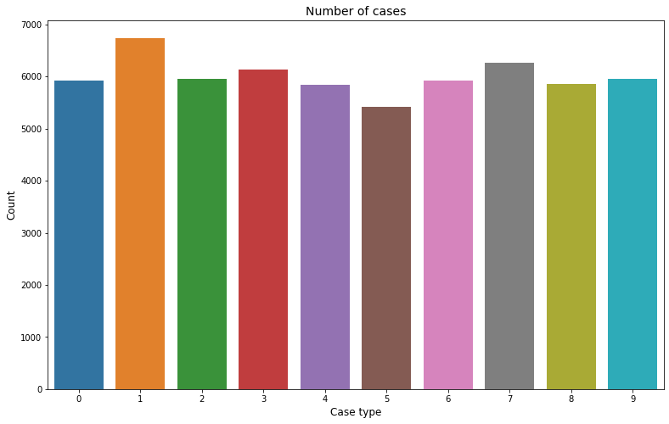
Trial Dataset with MNIST
Using the MNIST Dataset this is the break down of each of the categories

Slide 3
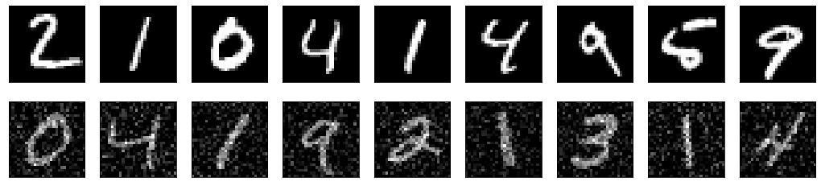
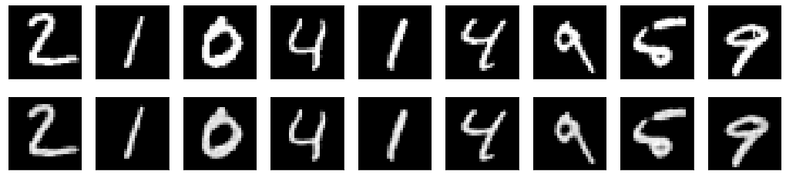
MNIST Autoencoded Images
output
input
input
output

Slide 4
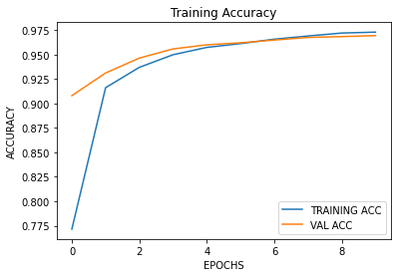
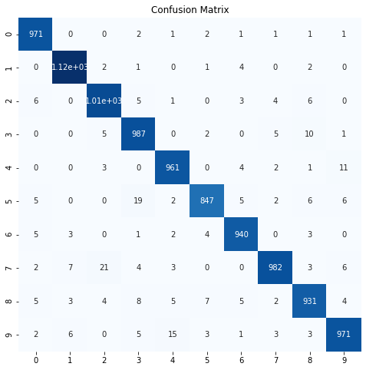
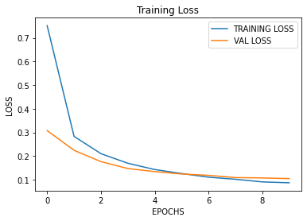
Mnist Classification
A good example of a well trained model.
High accuracy.
Small loss.
Well defined diagonal (accurate) images

Slide 5
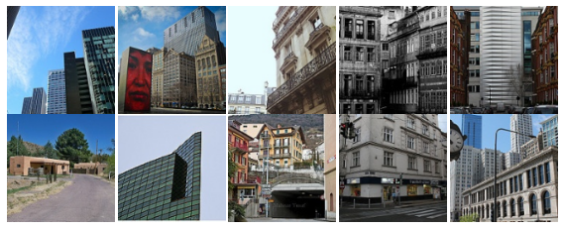
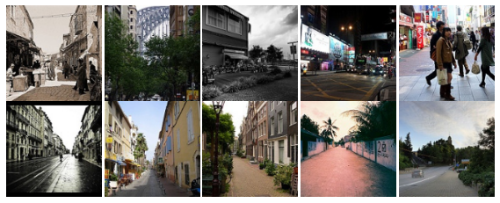
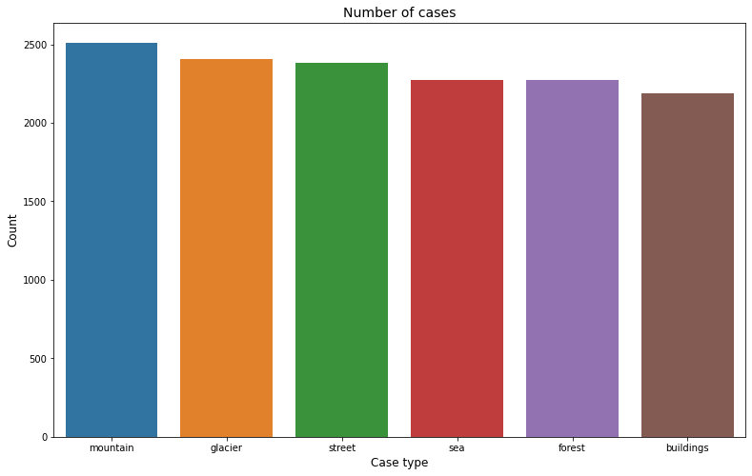
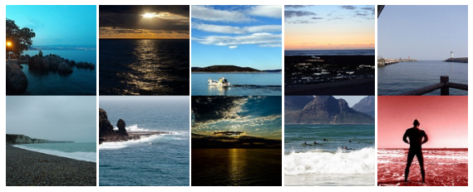
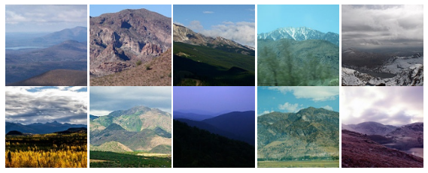
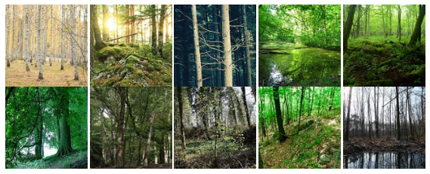
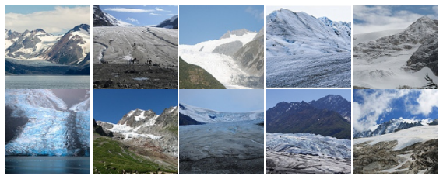
Control Images

Slide 6
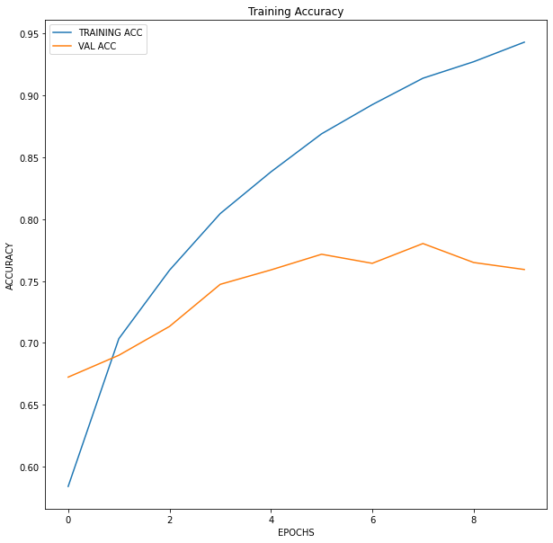
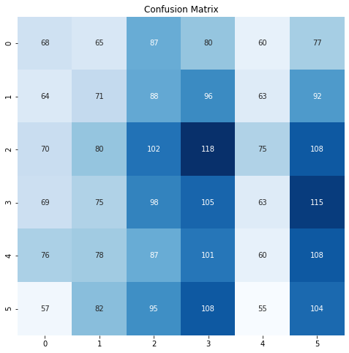
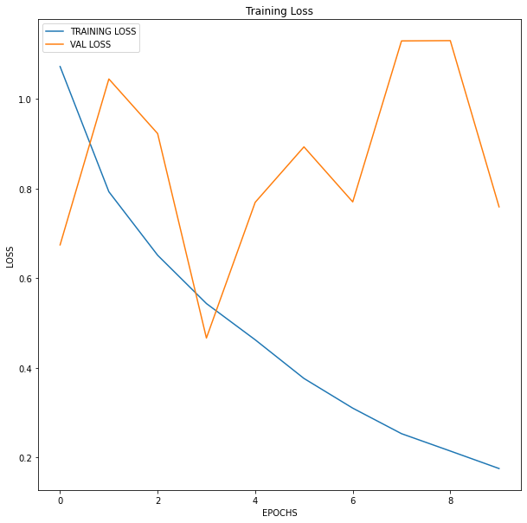
Control Image Classification
*Using original images

Slide 7
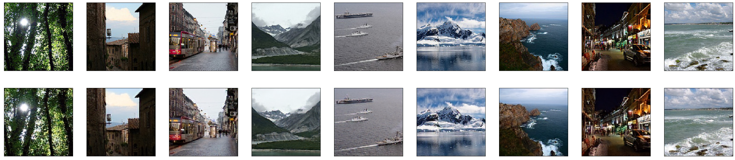
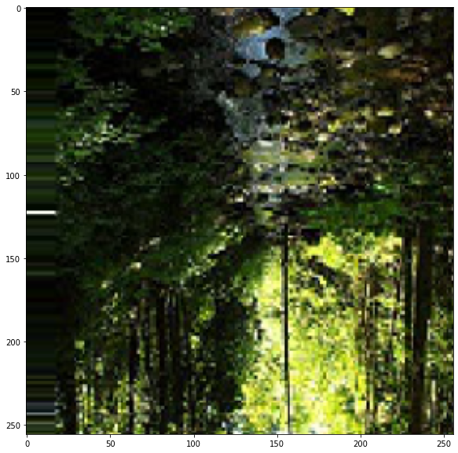

Autoencoded Kaggle Images
Autoencoded
(Augmented) Images
Input:
More defined
Output:
Blurrier image

Slide 8
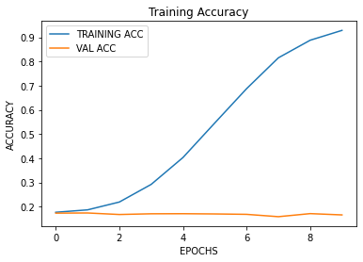
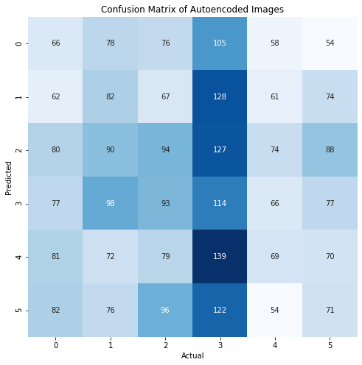
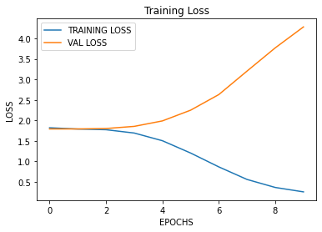
Augmented image classification
The model is training well but is not able to learn enough to apply to new images. May be overfitting.
The confusion matrix shows it does not have a good chance of identifying the correct image

Slide 9
Future Work
Have additional images for the model to train on
Create a better CNN model for a more thorough evaluation
Create a model that will use the encoded images and classify on that
Create variances of the autoencoder to learn the most it can from the images

Slide 10
Thank You

Slide 11
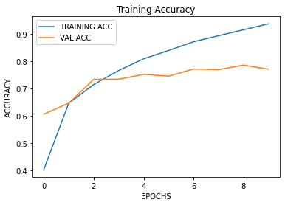
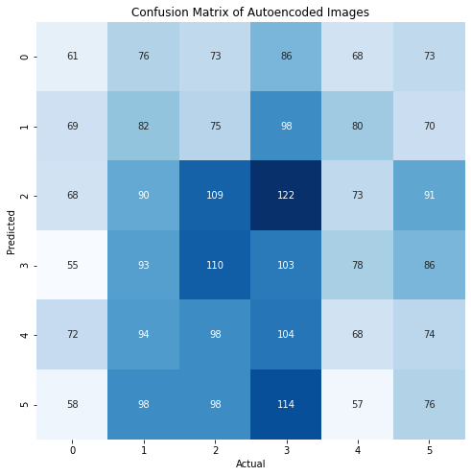
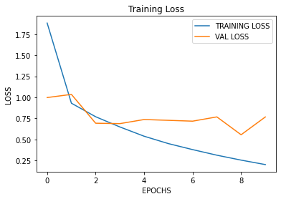
***Additional*** Encoded Image Classification
Encoded images (meaning condensed)
There is a rise in identifying image. Further investigation needed

